Slide 1
An Overview of Virginia’s School Accreditation Model in Preparation for Potential Changes Related to HB938
Presentation to the Board of Education
September 14, 2022

Slide 2
House Bill 938: Accountability-Related Goals (1 of 4)
Goal Three: Increasing the transparency of performance measures for public schools.
Framing the Task:
To support transparency, how can the Board and the Department help make complex concepts, like the accreditation model, more understandable to users?
What information do the School Quality Profiles already provide to school communities and constituents and what additional information is needed?
What additional actions could the Board or Department take to promote availability and transparency of data?

Slide 3
House Bill 938: Accountability-Related Goals (2 of 4)
Goal Four: Ensuring that performance measures for public elementary and secondary schools prioritize the attainment of grade-level proficiency and growth during the course of a school year and from school year to school year in reading and mathematics for all students, especially in grades kindergarten through five.
(Continued on Slide 3 of 4)

Slide 4
House Bill 938: Accountability-Related Goals (3 of 4)
Framing the Task:
How can the current methodology for including growth in accreditation be reconsidered in order to place emphasis on both growth and proficiency?
Should proficiency and growth be independent indicators in the accreditation model (vs. the combined rate)? And how does this work serve transparency?
How should the within-year measurement of growth facilitated by the "through year" growth assessments best be used?
How can a "year-to-year" measurement of growth continue to be included in school performance measures?

Slide 5
House Bill 938: Accountability-Related Goals (4 of 4)
Goal Six: Ensuring a strong accreditation system that promotes meaningful accountability year-over-year.
Framing the Task:
Are there changes that should be made to the current accreditation system to promote meaningful accountability year-over-year?
Should the option for triennial accreditation in which schools that are accredited for three years are automatically identified as “accredited” for three more years be removed to ensure all schools, both high and low performing, are assessed on an annual basis?

Slide 6
Types of Changes to Address House Bill 938
Solutions may:
require legislative change (Standards of Quality) or regulatory change (Standards of Accreditation). [Changes to the Standards of Accreditation would have to go through the required regulatory process];
require Board action only (do not need legislative or regulatory change);
only necessitate a change in “business rules”; or
only necessitate how information is reported to constituents.

Slide 7
Standards of Quality (SOQ): Legislative Authority for School Accreditation (1 of 2)
§ 22.1-253.13:3. Standard 3. Accreditation, other standards, assessments, and releases from state regulations.
The Board shall promulgate regulations establishing standards for accreditation pursuant to the Administrative Process Act (§ 2.2-4000 et seq.), which shall include (i) student outcome and growth measures, (ii) requirements and guidelines for instructional programs and for the integration of educational technology into such instructional programs, (iii) administrative and instructional staffing levels and positions, including staff positions for supporting educational technology, (iv) student services,
(continued on next slide)

Slide 8
Standards of Quality (SOQ): Legislative Authority for School Accreditation (2 of 2)
§ 22.1-253.13:3. Standard 3. Accreditation, other standards, assessments, and releases from state regulations.
(v) auxiliary education programs such as library and media services, (vi) requirements for graduation from high school, (vii) community relations, and (viii) the philosophy, goals, and objectives of public education in the Commonwealth.
The Board shall promulgate regulations establishing standards for accreditation of public virtual schools under the authority of the local school board that enroll students full time.
The Board's regulations establishing standards for accreditation shall ensure that the accreditation process is transparent and based on objective measurements and that any appeal of the accreditation status of a school is heard and decided by the Board.

Slide 9
Standards of Accreditation (SOA): Regulatory Authority
Chapter 131 Part VIII. School Accreditation
Section 370 Expectations for school accountability and accreditation
Section 380 Measurement of school quality for accreditation
Section 390 Accreditation
Section 400 Application of the school quality indicator performance levels to action
Section 410 Recognitions and rewards for school and division accountability
Section 420 Waivers and Alternative Accreditation Plans
Section 430 Effective Dates

Slide 10
Historical View of Accreditation (1 of 4)
Before the late 1990s, school accreditation was based on compliance with a set of requirements. School visits and document reviews were used to evaluate compliance.
As part of the reform that begin in 1995 with the revision of the Standards of Learning (SOL) and the implementation of the SOL testing program, there was a shift to an “outcome-based” model of accreditation. The intent was to set expectations for student achievement and provide schools with flexibility in determining how to meet those expectations.

Slide 11
Historical View of Accreditation (2 of 4)
The accreditation model was based primarily on SOL test pass rates in English (reading and writing), mathematics, science, and history/social science for “all students” and on a graduation and completion index for schools with a graduating class.

Slide 12
Historical View of Accreditation (3 of 4)
In 2013 and 2014, the General Assembly passed legislation that required the development of an A-F school grading system. The system was developed but was never implemented.
Instead, the “school quality profile” was developed to replace the old school report card and was intended to provide more transparent information to the public. (Note: Legislation to develop the school quality profile was carried by the same legislator who was the patron of the A-F grading system.)

Slide 13
Historical View of Accreditation (4 of 4)
In 2015, the General Assembly passed legislation that required the development of “differentiated” accreditation ratings:
Fully Accredited
Partially Accredited: Approaching Benchmark—Pass Rate
Partially Accredited: Approaching Benchmark—GCI
Partially Accredited: Improving School-Pass Rate
Partially Accredited: Improving School—GCI
Partially Accredited: Warned School—Pass Rate
Partially Accredited: Warned School-GCI
The differentiated ratings were used in reporting school accreditation in 2015-2016, 2016-2017 and 2017-2018.

Slide 14
Development of 2017 Accreditation Model
Development of the current model began in 2015.
Goals in developing the current system:
To provide a comprehensive picture of school quality;
To drive continuous improvement for all schools;
To build on strengths and address gaps in the current system; and
To inform areas of technical assistance and school improvement resources.
The first accreditation ratings under the current accreditation model were released in 2018-2019.

Slide 15
Key Understandings of Current Model

Slide 16
Accreditation Overview
Indicators
Academic Achievement-English
Academic Achievement-Mathematics
Academic Achievement-Science
Achievement Gap-English
Achievement Gap-Mathematics
Chronic Absenteeism
Graduation and Completion Index (GCI)
Dropout rate
College, Career, and Civic Readiness Index*
Each indicator is given a Performance Level:
Level One: At or above Standard
Level Two: Near Standard
Level Three: Below Standard
Performance Levels Determine Accreditation Status:
Accredited
Accredited with Conditions
*active for the first time in accreditation year 2023-2024

Slide 17
School Accreditation Ratings
ACCREDITED | Schools with all school-quality indicators at either Level One or Level Two
ACCREDITED WITH CONDITIONS | Schools with one or more school-quality indicators at Level Three
ACCREDITATION DENIED | Schools that fail to adopt or fully implement required corrective actions to address Level Three school-quality indicators.

Slide 18
Performance Levels (1 of 2)
Performance on each school-quality indicator is rated at one of three levels:
LEVEL ONE | Level One | Performance meets or exceeds the state standard by using the best of the current or cumulative three-year rate; OR current year rate is in the Level Two range and performance demonstrates adequate improvement from the previous year.
 | Level One (R10 or I2)
LEVEL TWO | Level Two | Performance meets a specified range using the best of the current or cumulative three-year rate; OR current year rate is in the Level Three range and performance demonstrates adequate improvement from the previous year.
 | Level Two (R10 or I2)

Slide 19
Performance Levels (2 of 2)
Performance on each school-quality indicator is rated at one of three levels:
LEVEL THREE | Level Three | Performance meets a specified range using the best of the current or cumulative three-year rate; OR performance has stayed at a Level Two or Level Three rating through four consecutive years (Level Three-4 YRS rating).
 | Level Three (4 YRS)

Slide 20
Achievement Indicators

Slide 21
Academic Achievement Performance Levels
 | English (Includes Reading and Writing Assessments) | Mathematics AND Science
LEVEL ONE Meets or exceeds state standard or sufficient improvement | Current or cumulative three-year rate is greater than or equal to 75% OR Current year rate is in the Level Two range (less than 75% but greater than 65%) and the school decreased the failure rate by at least 10% (R10) from the previous year. | Current or cumulative three-year rate is greater than or equal to 70% OR Current year rate is in the Level Two range (less than 70% but greater than 65%) and the school decreased the failure rate by at least 10% (R10) from the previous year.
LEVEL TWO Near state standard or sufficient improvement | Current year or cumulative three-year rate is less than 75% but greater than 65% OR Current year rate is greater than or equal to 50% and less than or equal to 65% and the school decreased the failure rate by at least 10% (R10) from the previous year. | Current year or cumulative three-year rate is less than 70% but greater than 65% OR Current year rate is greater than or equal to 50% and less than or equal to 65% and the school decreased the failure rate by at least 10% (R10) from the previous year.
LEVEL THREE School demonstrated performance below the benchmarks for Level One and Level Two. | Current year or cumulative three-year rate is less than or equal to 65% OR School has stayed at a Level Two or Three through four consecutive years. (Level Three - 4 Years Rating) | Current year or cumulative three-year rate is less than or equal to 65% OR School has stayed at a Level Two or Three through four consecutive years. (Level Three - 4 Years Rating)

Slide 22
Rates used for Achievement Indicators
Indicator(s) | Elementary and Middle Schools | High Schools
Academic Achievement: Mathematics Achievement GAP: Mathematics | Combined Rate Includes students with passing tests and failing tests that show growth | Accreditation Pass Rate
Academic Achievement: English Achievement GAP: English | Combined Rate Includes students with a passing reading and/or writing test, students with a failing reading test that show growth, and EL students who have not passed the reading test and have not shown growth but do show progress on the WIDA Access for ELLs test. | Combined Rate Includes students with a passing reading and/or writing test, and EL students who have not passed the reading test but do show progress on the WIDA Access for ELLs test.
Academic Achievement Science | Accreditation Pass Rate | Accreditation Pass Rate

Slide 23
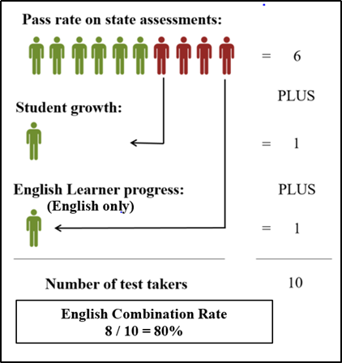
Combined Rate Example: English
A student will be counted in the numerator of the English combined rate if:
The student passes the assessment(s); or
The student does not pass the reading assessment but demonstrates growth; or
For the English rate only, the student does not pass the reading assessment or demonstrate growth, but is an EL and demonstrates progress as measured by the ACCESS for ELLs 2.0 assessment.

Slide 24
Information Regarding Test Records (1 of 2)
Achievement rates include Includes Standards of Learning (SOL), Virginia Alternate Assessment Program (VAAP) tests, and most substitute tests.
Test records are from the previous summer (end-of-course SOL tests only), current fall, and current spring test administrations.

Slide 25
Information Regarding Test Records (2 of 2)
Accreditation pass rates and combined rates for English and mathematics achievement indicators include credit for tests marked as “recovery.”
Example: A student fails the 4th grade reading SOL test. The student receives remediation by attending summer school. In the 5th grade, this student’s test record is marked as “recovery.” The student passes the 5th grade reading test. This test record is counted as 2 in the numerator and 2 in the denominator.

Slide 26
Example of a Combined Rate
Indicator | Data Source | Passing | Recovery | Growth | EL Progress | Total Tests (includes recovery) | Rate | Level | Final Performance Level
All Students | Current Year | 168 | 2 | 7 | 13 | 248 | 76.61 | Level One | Level One
 | Previous Year | 176 | 6 | 15 | 13 | 252 | 80.15
 | Cumulative Three Year Rate | 514 | 19 | 32 | 35 | 760 | 78.95 | *Level One
Numerator Denominator

Slide 27
Achievement Gap Indicator
The data is reported out by student groups:
Asian students
Black students
Hispanic Students
Multiple Races
White Students
Economically Disadvantaged students
English Learners
Students with Disabilities (excludes 504 students)
Each student group is given a performance level rating. The combination of the student group ratings determine the overall rating of the indicator.

Slide 28
Assigning a Level to the Achievement Gap Indicator
Student Group | School A | School B | School C
Asian | Level One | Level One | Level One
Black | Level One | Level Two | Level One
Hispanic | Level One | Level Two | Level Three
Multiple Races | Level One | Level One | Level One
White | Level Two | Level One | Level One
Economically disadvantaged | Level One | Level One | Level Three
English Learners | Level One | Level One | Level Two
Students with Disabilities | Level One | Level Three | Level Two
Final Performance Level | Level One | Level Two | Level Three

Slide 29
Chronic Absenteeism

Slide 30
Chronic Absenteeism Indicator
Indicator | Elementary, Middle, and High Schools
Chronic Absenteeism | Percent of students who are absent 10% or more of enrolled days.
$$Student^{′}s Absenteeism Rate= \frac{Total days absent in a given school year}{Total days in membership in a given school year}$$
$$Chronic Abenteeism Rate= \frac{number of students whose absenteeism rate is≥10\% }{All students whose end−of−year membership is ≥ 50\%}$$

Slide 31
Chronic Absenteeism Performance Level Descriptors
Level | Description
LEVEL ONE Meets or exceeds state standard or sufficient improvement | Current or cumulative three-year rate is 15% or lower OR Current year rate is in Level Two range and decreased rate by at least 10% (R10) from previous year.
LEVEL TWO Near state standard or sufficient improvement | Current year or cumulative three-year rate is greater than 15% but less than or equal to 25% OR Current year rate is in level three range and decreased rate by at least 10% (R10) from previous year.
LEVEL THREE School demonstrated performance below the benchmarks for Level One and Level Two. | Current year or cumulative three- year rate is more than 25% OR School has stayed at a Level Two or three through four consecutive years. (Level Three - 4 Years Rating)

Slide 32
For schools with a grade 12: Graduation and Completion Index (GCI); Dropout Rate; College, Career, and Civic Readiness Index (CCCRI)

Slide 33
Graduation and Completion Index and Dropout Indicators
Indicator | High Schools
Graduation and Completion Index (GCI) | Weighted value based on outcomes for the adjusted on-time graduation cohort plus carry-over students.
Dropout Rate | Dropout Rate: Any student who is a “dropout” or “unconfirmed” in the On-time Graduation Cohort divided by the Number of Students in the On-time Graduation Cohort.

Slide 34
GCI Calculation Example
Outcome | Number of Students (adjusted and carry-over students) | Number of Points per Outcome | Points in Numerator
Diploma | 154 | 100 | 15,400
GED | 5 | 75 | 375
Certificate of Completion | 2 | 25 | 50
Still Enrolled (remain active) | 6 | 70 | 420
Dropouts | 3 | 0 | 0
Total | 170 |  | 16,245
$$GCI=\frac{16,245}{17,000}=95.56$$

Slide 35
GCI and Dropout Rate Performance Level Descriptors
 | GCI | Dropout Rate
LEVEL ONE Meets or exceeds state standard or sufficient improvement | Current or cumulative three-year rate is greater than or equal to 88 OR Current year rate is in Level Two range and increased rate by at least 2.5% (I2) from previous year. | Current or cumulative three-year rate is less than or equal to 6% OR Current year rate is in Level Two range and decreased rate by at least 10% (R10) from previous year.
LEVEL TWO Near state standard or sufficient improvement | Current year or cumulative three-year rate is less than 88 but greater than 80 OR Current year rate is in a level three range and increased rate by at least 2.5% (I2) from previous year. | Current year or cumulative three-year rate is greater than 6% but less than or equal to 9% OR Current year rate is in level three range and decreased rate by at least 10% (R10) from previous year.
LEVEL THREE School demonstrated performance below the benchmarks for Level One and Level Two. | Current year or cumulative three-year rate is less than or equal to 80 OR School has stayed at a Level Two or three through four consecutive years. (Level Three - 4 Years Rating) | Current year or cumulative three- year rate is greater than 9% OR School has stayed at a Level Two or three through four consecutive years. (Level Three - 4 Years Rating)

Slide 36
College, Career, and Civic Readiness Index
Indicator | High Schools
College, Career, and Civics Readiness (CCCRI)* | A measure that gives students credit for certain advanced coursework, CTE credentials, work-based learning, or service learning experiences.

Slide 37
Who is included in this Indicator?
Unduplicated count of students in the on-time graduation cohort who:
complete an AP, IB, Cambridge, or dual enrollment course;
earned two or more standard credits for a state-approved sequence in a CTE program and earned a CTE credential;
completed a work-based learning experience;
completed a service-learning experience; or
completed three or more JROTC courses and earned an approved industry credential.
The CCCRI rate calculation is:
$$\frac{\text{the} \text{number} \text{of} \text{students} \text{who} \text{meet} \text{at} \text{least} \text{one} \text{criteria}}{\text{number} \text{of} \text{students} \text{in} \text{the} \text{on}\text{−}\text{time} \text{graduation} \text{cohort}}$$

Slide 38
CCCRI Level Descriptions
Level | Description
LEVEL ONE Meets or exceeds state standard or sufficient improvement | Current rate is greater than or equal to 85%
LEVEL TWO Near state standard or sufficient improvement | Current rate is less than 85% but greater than 70%
LEVEL THREE School demonstrated performance below the benchmarks for Level One and Level Two. | Current rate is less than or equal to 70%

Slide 39
Availability of Data

Slide 40
School Quality Profiles
Provides a snapshot of data at the state, division, and school level.
Enter school name to see that school’s profile.

Slide 41
School Quality Profiles: Accreditation tab (1 of 8)
Provides the accreditation status of the school.

Slide 42
School Quality Profiles: Accreditation tab (2 of 8)
Provides the performance level of each indicator.

Slide 43
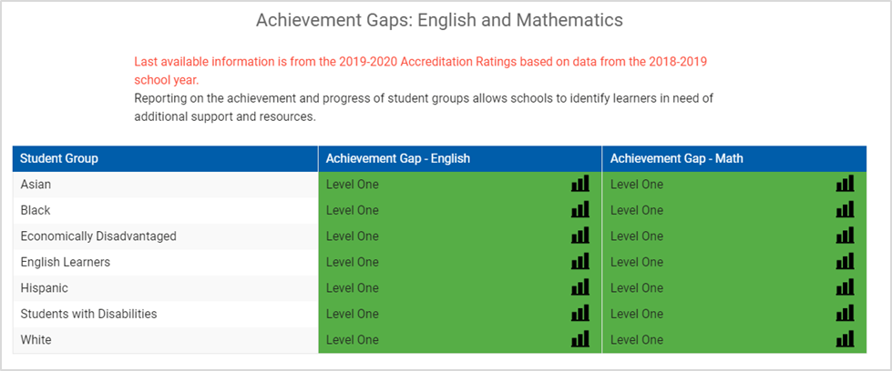
School Quality Profiles: Accreditation tab (3 of 8)
School Quality Profiles: Accreditation tab (3 of 8)
Includes the performance levels for each student group.

Slide 44
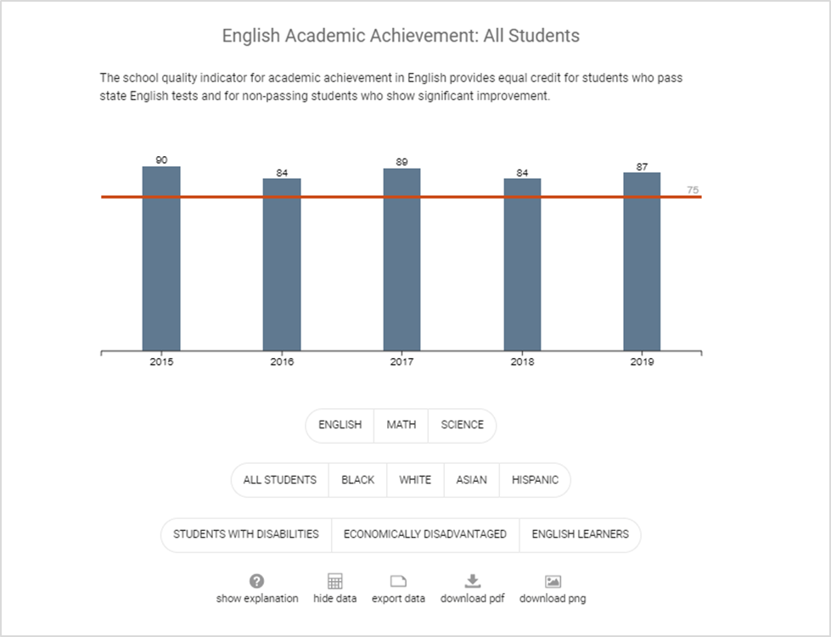
School Quality Profiles: Accreditation tab (4 of 8)
The accreditation rates a school earned are shown for English, math and science, as well as for each of the student groups. Selecting the buttons below the bar graph changes the bar graph display. In addition, historical results are displayed.

Slide 45
School Quality Profiles: Accreditation tab (5 of 8)
There is a table that disaggregates the rate into its components.

Slide 46
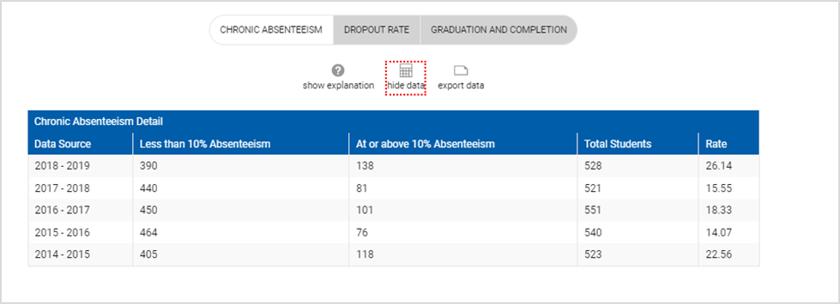
School Quality Profiles: Accreditation tab (6 of 8)
In addition, there is information on chronic absenteeism;

Slide 47
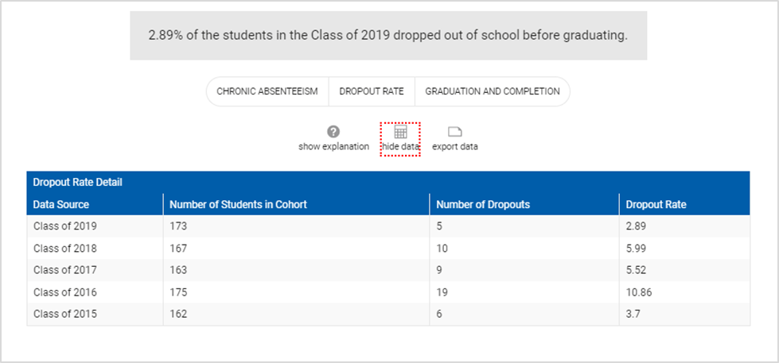
School Quality Profiles: Accreditation tab (7 of 8)
Dropout rates;

Slide 48
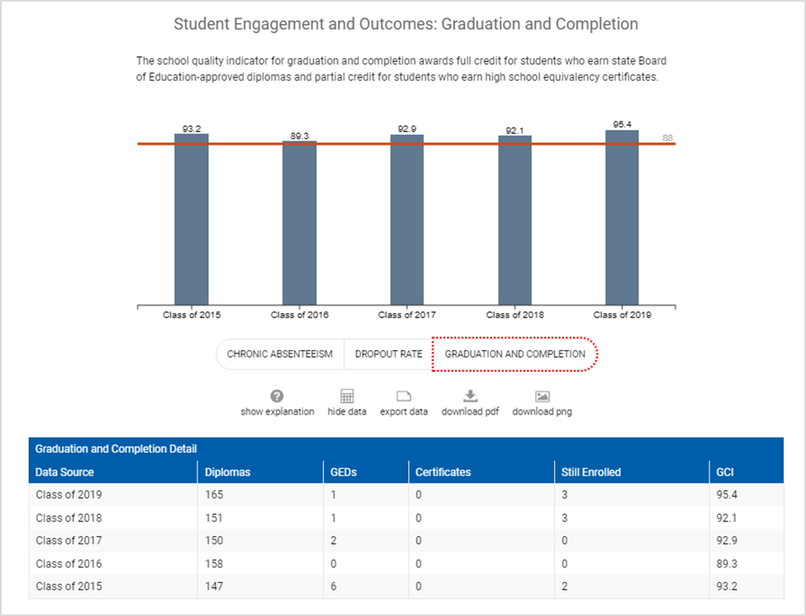
School Quality Profiles: Accreditation tab (8 of 8)
and the Graduation and Completion Index.

Slide 49
School Quality Profiles: Assessment Tab (1 of 2)
The Assessment tab displays annual pass rates on state assessments in reading, writing, mathematics, science, and history.
For reading and mathematics, this rate does not include data that is included in accreditation calculations, such as growth, recovery, and English Learner Progress.
At the school level, overall subject area results are displayed plus annual pass rates by test.

Slide 50
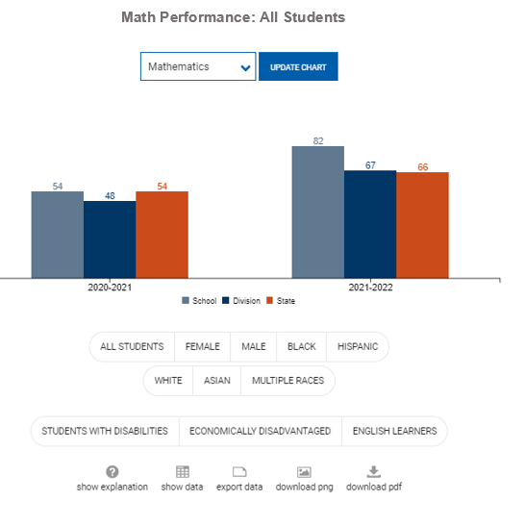
School Quality Profiles: Assessment Tab (2 of 2)
There is a bar graph for each subject area that looks similar to this image. Selecting the buttons below the bar graph changes the bar graph display.
This dropdown allows the user to also select a specific test.

Slide 51
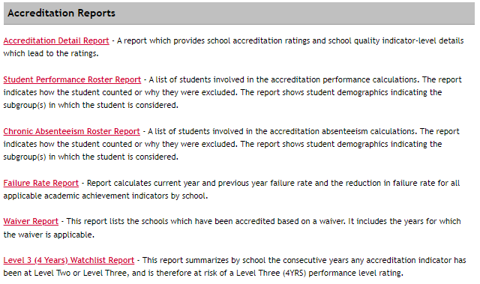
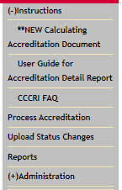
SSWS Resources for School Divisions (1 of 2)

Slide 52
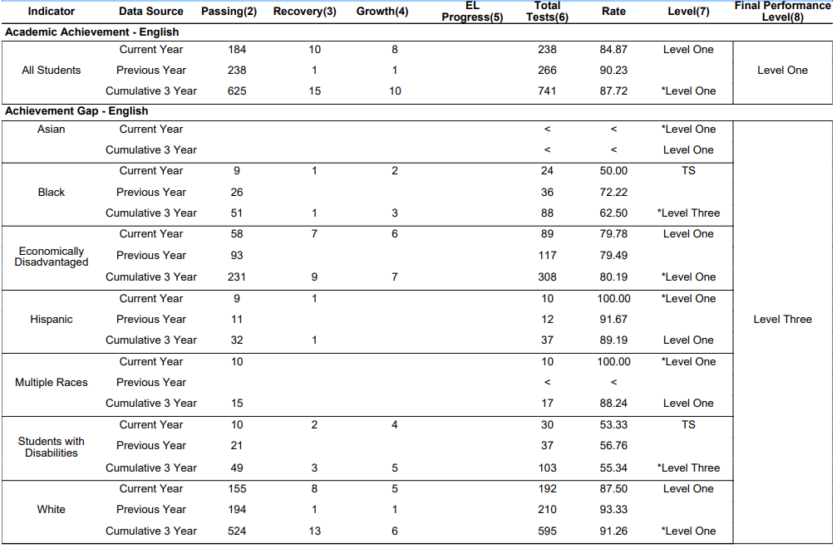
Example: Accreditation Detail Report (1 of 2)

Slide 53
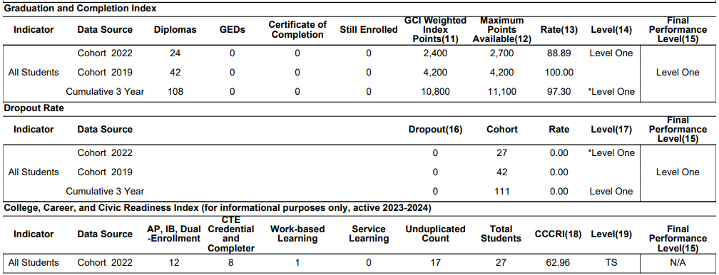
Example: Accreditation Detail Report (2 of 2)

Slide 54
Board Discussion

Slide 55
House Bill 938 Board Discussion: Transparency
What can be done to make the model more understandable to users?
What additional information is needed on the School Quality Profiles?
What additional actions could the Board or Department take to promote availability and transparency of data?

Slide 56
Proficiency and Growth Measures

Slide 57
House Bill 938 Board Discussion: Proficiency and Growth
How can the current methodology for including growth in accreditation be reconsidered in order to place emphasis on both growth and proficiency?
How should the within-year measurement of growth facilitated by the "through year" growth assessments best be used?
How can a "year-to-year" measurement of growth continue to be included in school performance measures?

Slide 58
Measuring Growth in the 2021-2022 School Year
Legislation passed in the 2021 General Assembly (HB2027 and SB1357) required the implementation of “through year” growth assessments in reading and mathematics in grades 3-8.
The growth assessments administered in fall 2021 were based on content from the student’s previous grade level.
Example: Students enrolled in grade 5 mathematics in fall 2021 completed fall growth assessments based on grade 4 mathematics.
Students who failed the spring 2022 SOL test could demonstrate growth by comparing a failing spring 2022 SOL test to either the previous spring 2021 SOL test or the fall 2021 growth assessment.

Slide 59
Growth Assessments in the 2022-2023 School Year and Beyond (1 of 2)
In 2022-2023 the grades 3-8 reading and mathematics growth assessments will be administered to students once in the fall and once in the winter (mid-year) during the school year.
In addition, the normally occurring spring SOL tests for grades 3-8 reading and mathematics will continue to be administered.

Slide 60
Growth Assessments in the 2022-2023 School Year and Beyond (2 of 2)
The fall and winter growth assessments will focus primarily on content from the student’s current grade level.
Example: A student taking grade 5 mathematics in 2022-2023 will be administered a fall and winter (mid-year) growth assessment that focuses on grade 5 mathematics standards.

Slide 61
Measuring Growth in 2022-2023
Because of the additional winter growth assessment, and the changes to the growth assessments (which are primarily on grade level), a different growth methodology is likely needed.
This methodology has not yet been finalized.

Slide 62
House Bill 938 Board Discussion: Proficiency and Growth
How can the current methodology for including growth in accreditation be reconsidered in order to place emphasis on both growth and proficiency?
How should the within-year measurement of growth facilitated by the "through year" growth assessments best be used?
How can a "year-to-year" measurement of growth continue to be included in school performance measures?

Slide 63
Potential Changes to Student Growth Measures
(8VAC20-131-380.F.5) The Board has the authority to determine how growth is used in the accreditation model.
“The board may adopt valid and reliable measures of student growth to be used in calculating the Academic Achievement Indicators for English and mathematics and in determining the progress of English learners toward English proficiency.”

Slide 64
Meaningful Accountability

Slide 65
House Bill 938 Board Discussion: Meaningful Accountability
Are there changes that should be made to the current accreditation system to promote meaningful accountability year-over-year?
Should the option for triennial accreditation in which schools that are accredited for three years are automatically identified as “accredited” for three more years be removed to ensure all schools, both high and low performing, are assessed on an annual basis?

Slide 66
Triennial Accreditation
§ 22.1-253.13:3. The Board shall review the accreditation status of a school once every three years if the school has been fully accredited for three consecutive years. Upon such triennial review, the Board shall review the accreditation status of the school for each individual year within that triennial review period. If the Board finds that the school would have been accredited every year of that triennial review period the Board shall accredit the school for another three years.

Slide 67
Other Potential Changes to the Accreditation Model

Slide 68
Inclusion of Additional Indicators (1 of 2)
Allowable under 8VAC20-131-380.F.7.
“The board may incorporate additional indicators of school quality used for accreditation into this chapter according to the criteria in subsection A of this section, provided that when the board incorporates additional indicators, the board shall also establish performance benchmarks to assign performance levels.”

Slide 69
Inclusion of Additional Indicators (2 of 2)
The additional indicator must adhere to these best practices:
Research demonstrates that the indicator is related to academic performance;
Standardized procedures exist across schools and school divisions for collection of data used for the indicator;
The data about the indicator is reliable and valid;
Performance in the indicator can be positively impacted through division and school-level policies and procedures;
The measure meaningfully differentiates among schools based on progress of all students and student reporting groups;
The indicator does not unfairly impact one type or group of schools or students; and
The indicator is moderately to strongly correlated with school-level pass rates on state assessments.

Slide 70
Changes to Benchmarks for Indicator Performance Levels
The Board has authority to adjust benchmarks.
8VAC20-131-380.F.2
“To focus on continuous improvement for all schools, the benchmarks delineating the performance levels provided in subdivision 1 of this subsection may be adjusted as provided in subsection D of this section, through board-approved guidance. Adequate notice shall be provided to local school boards of any such adjustment.”

Slide 71
Definition of School Accreditation Ratings
8VAC20-131-390. Accreditation B. Accreditation ratings. Effective no later than the academic year 2018-2019, schools that meet the conditions described in subsection A of this section shall be assigned one of the following accreditation designations as described in this section.
Accredited: When a school has each of its school quality indicators at Level One or Level Two, it shall be "Accredited." For the transition year of 2018-2019, when a school meets the accreditation standards for designation as accredited under either the 2017-2018 accreditation calculation rules or the 2018-2019 rules for multiple school quality indicators, it shall be designated "Accredited."
Accredited with Conditions: When a school has any school quality indicator at Level Three, it shall be "Accredited with Conditions."
Accreditation Denied: If a school is designated "Accredited with Conditions," and the school or school division fails to adopt and implement school division or school corrective action plans with fidelity as specified by 8VAC20-131-400.D, it may be designated by the board as "Accreditation Denied" as provided in 8VAC20-131-400 D.4.

Slide 72
Other Potential Changes
Many other accountability models exist if the board desires additional changes or a completely different system.
The level of modification required to the current system will determine whether the change can be effected by Board action or whether a revision to the Standards of Accreditation or the Standards of Quality will be required.

Slide 73
Next Steps
Recommendations for changes from the HB938 stakeholders group will be presented to the board.
A report on the stakeholder findings and recommendations is due to the Chairmen of the House and Senate Education Committees no later than November 30, 2022.

